Slide 1
ANTICIPATING YOUR OPPONENT’S NEXT MOVE . PREDICTING PASS VS. RUN IN THE NFL COLLEEN KENNEY GENERAL ASSEMBLY 2019

Slide 2
BACKGROUND
NFL has two main play types:
Pass
Run
NFL coaches spend almost half their day watching film

Slide 3

PROBLEM STATEMENT
Can we use machine learning to predict whether or not a team will run or pass?

Slide 4
APPROACH
Data Collection
EDA & Feature Engineering
Modeling

Slide 5
DATA COLLECTION
320,000+ plays
From 2009 Week 1 to 2018 Week 15
2500+ forecasts
One for each game
57.8%
Baseline accuracy score

Slide 6
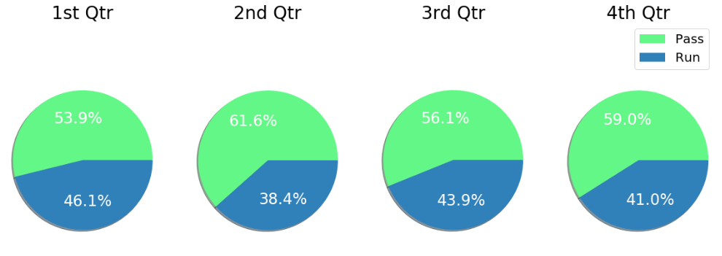
EXPLORATORY DATA ANALYSIS
NFL Runs are most popular in Q1, decline in Q2, pick back up again in Q3, and decline again in Q4

Slide 7
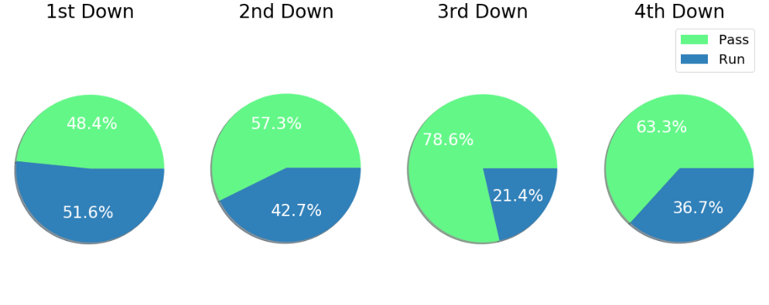
EXPLORATORY DATA ANALYSIS
NFL Runs are most popular on 1st Down, Passes are most popular on 3rd Down

Slide 8
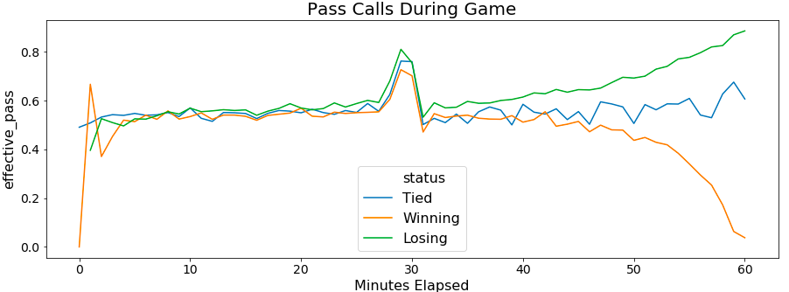
EXPLORATORY DATA ANALYSIS
No matter the score, all teams pass more at the end of Q2
Winning teams pass much less than losing / tied teams

Slide 9
FEATURE ENGINEERING
Precipitation – binary variable
Tendencies – rolling average of past 5 play calls for that team in that game
Interaction Terms for Distance & Down
Short < 4 yards to go
Medium between 4 and 7 yards to go
Long > 7 yards to go

Slide 10
MODELING
Defined function to test 6 different classification models
Choose best model and optimize model
Interpret Results

Slide 11
ACCURACY RATES – 57.8% Baseline
Model | Test Accuracy Score | Train Accuracy Score
XGBoost | 69.65% | 70.15%
Neural Network | 69.43% | 71.26%
Random Forest | 67.63% | 98.42%
Extra Trees | 66.92% | 99.99%
Logistic Regression | 65.94% | 66.40%
Gaussian Naïve Bayes | 62.54% | 62.54%
Optimizing hyperparameters for XGBoost increased accuracy to 70.6%

Slide 12
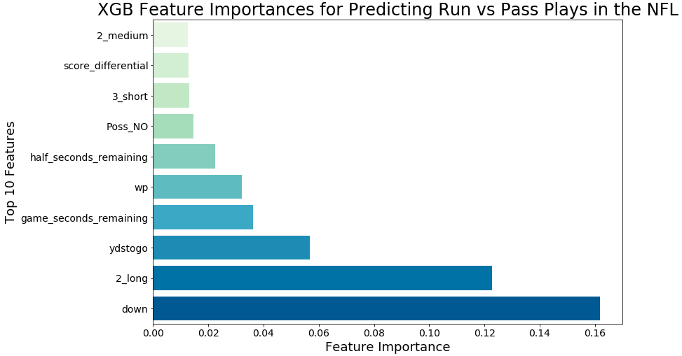
FEATURE IMPORTANCES

Slide 13
CONFUSION MATRIX
 | Pred Pass | Pred Run
True Pass | 33760 | 12630
True Run | 10923 | 22860
Specificity (Ability to correctly predict negative): 73%
Sensitivity (Ability to correctly predict positive): 68%
Better able to predict pass (negative) than run (positive)

Slide 14
SITUATIONAL ACCURACY
Some plays are easy to predict
Ex. 3rd and Long is most likely going to be a pass play
How does the model perform in situations that are less obvious?
1st & Long is the biggest toss up with baseline accuracy of 51%
Model achieved 65% accuracy
3rd & Short is another toss up with baseline accuracy of 55%
Model achieved 75% accuracy
Largest marginal increase in accuracy from baseline

Slide 15
FLASK APP
http://127.0.0.1:5000/form

Slide 16
CONCLUSIONS & NEXT STEPS
70.6% Accuracy which is well above the baseline of 57.8% but there is definitely room for improvement
Down, time, yards to go, and the score are all important factors in predicting play type
Next Steps
Gather more plays
Gather other features (who is on the field, a teams tendencies over a season, etc.)
Meet with football coaches to understand their thought process in approaching plays

Slide 17
ANY QUESTIONS?
Thank you!

